Slide 1


ENS 491-492 – Graduation Project
Prediction of Remaining Life of the Aircraft Engine
Supervisor(s): Ahmet Demirelli
Group Members:
Berfu Aydın – 23520
Ahmet Rauf Yavuz - 23887

Slide 2
The Issue or problem that was solved/researched
Aviation sector is getting more and more important today. In addition to building aircraft, their maintenance is quite difficult and costly. Aircraft that are not maintained or whose condition is uncertain cause irreparable casualties. Our starting point in this project: It is to prevent high costs and loss of life by ensuring that the aircraft that are close to the end of their engine life are detected in advance and the engine supply is made as quickly as possible

Slide 3
The Issue or problem that was solved/researched
Our project aims to create machine learning algorithms to predict the remaining life of the aircraft engine based on approximately 20 sensor data obtained from jet aircraft engines. While doing this, it will be determined which model will work more effectively and with high accuracy by using different RNN models available in the literature. In this process, synthetic data we have obtained from NASA will be used.

Slide 4
ObjectIves/Tasks
The aim so far is to recognize the available data and to find correlations between them by visualizing these data. This part, called data processing, is one of the most important parts before the machine learning model is created. In this way, the model is purified from unnecessary data and creates a measure for the result to be more consistent and for possible problems to be encountered in the future.

Slide 5
Methodology or technIques that were utIlIzed In the project
LSTM
BLSTM
Random Forest
Naive Bayes
Cross-validation

Slide 6
Lstm
First method that we agreed to work with in this project is LSTM(Long Short-Term Memory). LSTM is a type of recurrent neural network that can learn order dependence in sequence prediction problems.
LSTM is one of the Recurrent Neural Network methods. Recurrent Neural Networks (RNN) are more useful when working with sequential data. They basically derived from feed forward networks but RNNs perform similar behaviours to human thinking. RNNs don't make evaluations by not only looking at the actual input parameters, they also consider the previous inputs.

Slide 7
blstm
LSTMs solved vanishing gradients and exploding gradients problems. These problems are related to the training part of the network .

Slide 8
Naïve Bayes
Another algorithm that we used is the Gaussian Naïve Bayes algorithm. Naïve Bayes is a machine learning model that assigns class labels to problem occurrences. It is a simple classification technique but it is working well. However, we need to use Gaussian Naive Bayes because our data contains continuous values and it is a regression problem.

Slide 9
Random forest
Another method that we decided to use in this project is the Random Forest algorithm which is a widely - known ensemble algorithm both used for classification and regression problems. Random Forest is a combination of multiple decision trees.

Slide 10
K-fold cross valıdatıon
Later steps on the project we decided to enhance the results from our random forest algorithm with K-Fold Cross Validation. Cross- validation is a resampling process used to evaluate machine learning models. Cross validation is mainly used in machine learning to estimate the ability (how good a model is) of the model with unseen data.

Slide 11
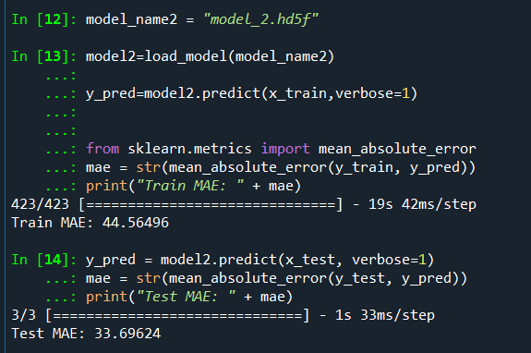
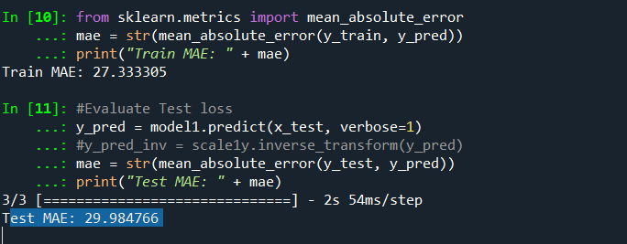
Results and FIndIngs
Result of BLSTM:
  In our BLSTM model we got the best score which is 29.98 Mean Absolute error. In statistics, mean absolute error (MAE) is a measure of errors between paired observations expressing the same phenomenon.
Result of LSTM

Slide 12
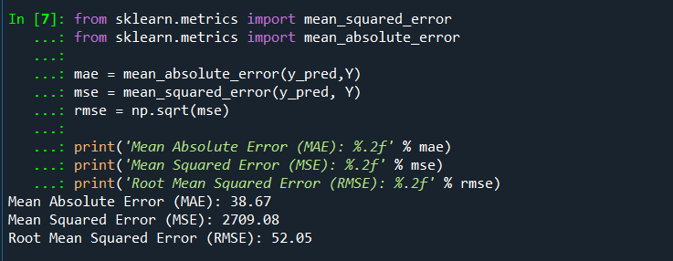
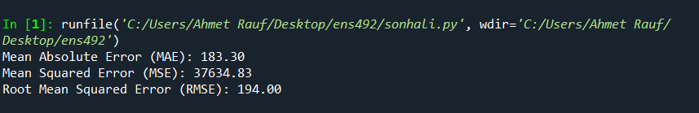
Results and FIndIngs
Result of Random Forest
Result of Naive Bayes
  When we used Naive Bayes, we got a score like 183.30. Obviously it was a bad result compared to other models. It was a model that we did not prefer, but still we wanted to put it in our visuals for us to see and compare.

Slide 13
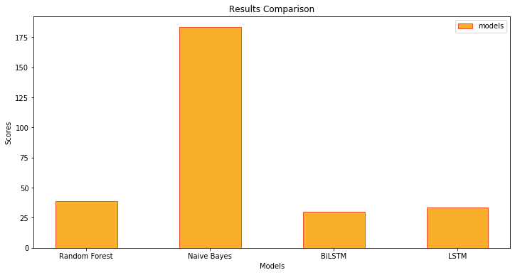
Results comparıson
We used mean square error scores to evaluate the results.

Slide 14
Thank you

Slide 15
references
1.https://medium.com/@gulcanogundur/overfitting-a%C5%9F%C4%B1r%C4%B1-%C3%B6%C4%9Frenme-underfitting-eksik-%C3%B6%C4%9Frenme-ve-bias-variance-%C3%A7eli%C5%9Fkisi-b92bef2f770d
2.https://medium.com/@gulcanogundur/overfitting-a%C5%9F%C4%B1r%C4%B1-%C3%B6%C4%9Frenme-underfitting-eksik-%C3%B6%C4%9Frenme-ve-bias-variance-%C3%A7eli%C5%9Fkisi-b92bef2f770d#:~:text=A%C5%9F%C4%B1r%C4%B1%20%C3%B6%C4%9Frenmenin%20aksine%2C%20bir%20model,verilerdeki%20trendleri%20ka%C3%A7%C4%B1rd%C4%B1%C4%9F%C4%B1%20anlam%C4%B1na%20gelir.&text=Underfitting%20sorunu%20olan%20modellerde%20hem,ve%20y%C3%BCksek%20bias'a%20sahiptir.
3.https://www.hindawi.com/journals/complexity/2018/3813029/#copyright
4. Nieto, PJ García, et al. "Hybrid PSO–SVM-based method for forecasting of the remaining useful life for aircraft engines and evaluation of its reliability." Reliability Engineering & System Safety 138 (2015): 219-231.
5.5.Yoshua Bengio, et al., Learning Long-Term Dependencies with Gradient Descent is Difficult, 1994.
6.Alex Graves, et al., Framewise Phoneme Classification with Bidirectional LSTM and Other Neural Network Architectures, 2005.
.7.Felix A. Gers, et al., Learning to Forget: Continual Prediction with LSTM, 2000

